Slide 1
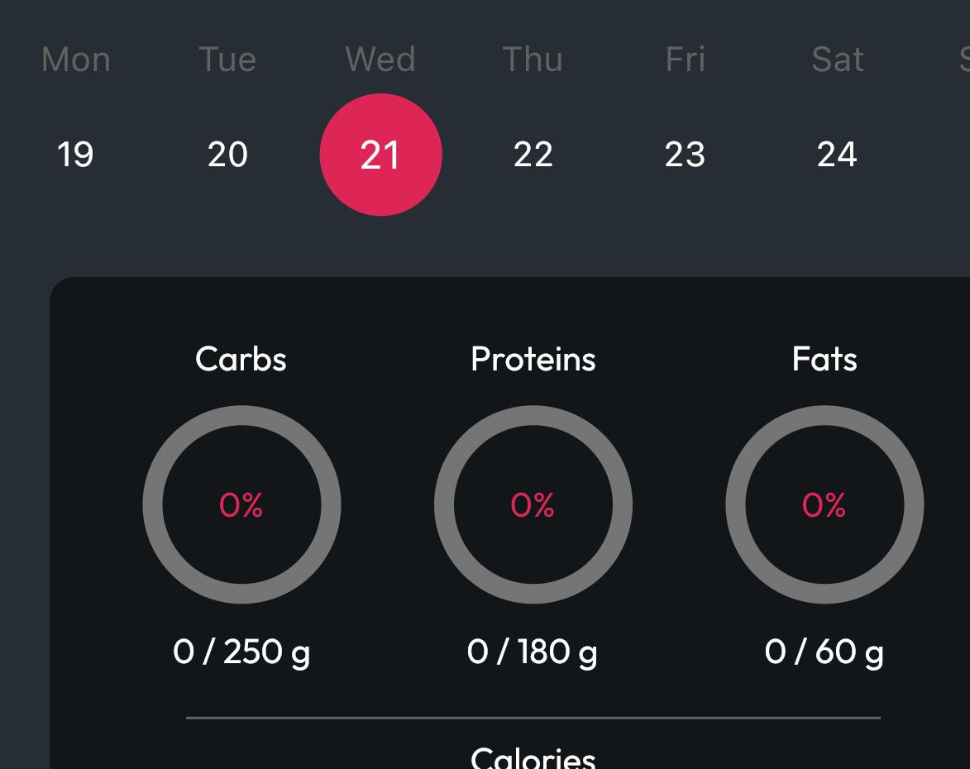
DIMA - MacroTracker
Sironi Alessandro, Sprocati Tommaso

Slide 2

The App & Features
MacroTracker is a fitness-focused project that allows athletes to track and log food intake and macro- nutrients in order to compile statistics of one’s eating habits
Tracking of the Daily Diet
Manual Insert
Scan of Barcode
Apple HealthKit integration
Notification Reminders

Slide 3


Technical Overview
Application developed in Flutter for iPhone and iPad
Two Tier Architecture
Backend with Google FireBase
Authentication
Firestore Database

Slide 4
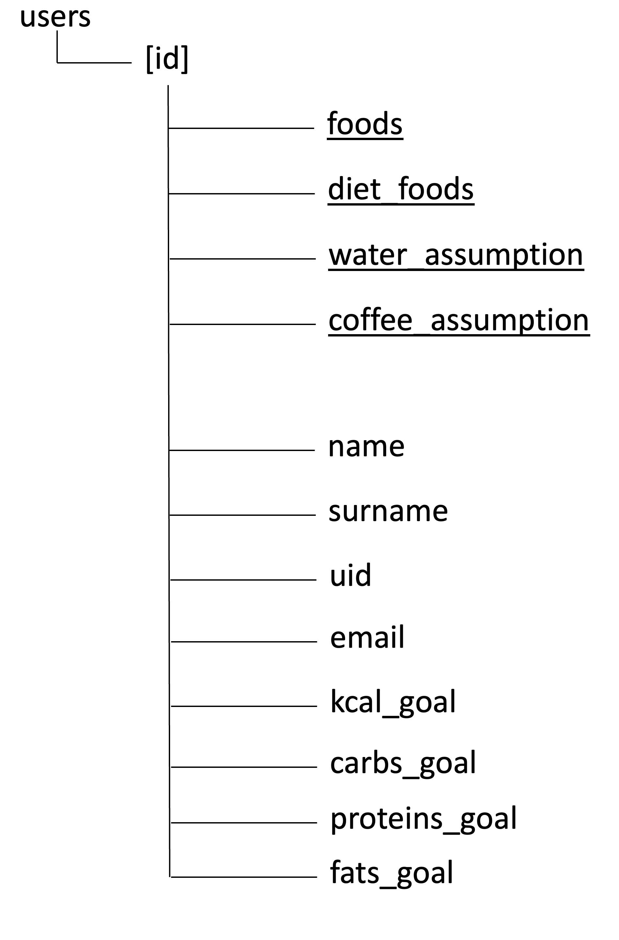
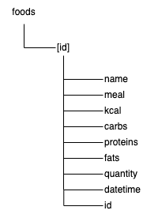
Database Structure

Slide 5
External Services & Plugins
OpenFoodFacts API
Flutter Local Notification
Health
Cloud Firestore
Firebase Authentication
Flutter Barcode Scanner

Slide 6
Testing
Widget Testing
Integration Testing
User Testing

Slide 7
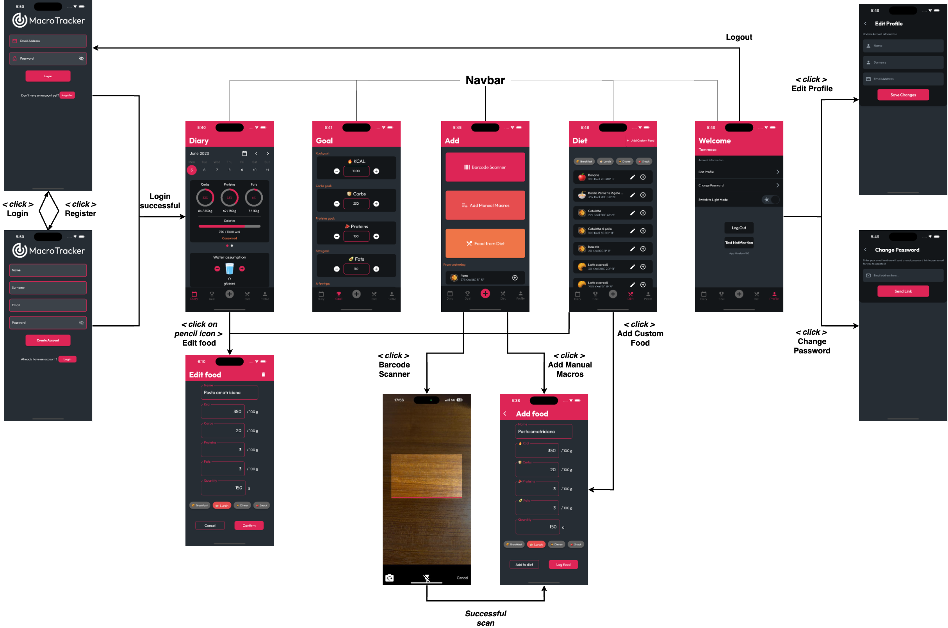
UX

Slide 8
DEMO

